Slide 1
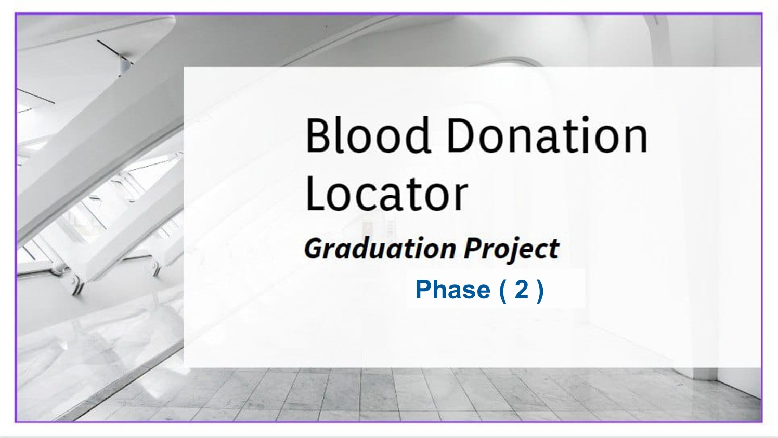

Slide 2
Our team
Ahmed Tarek Radwan
Ahmed Abd Elnasser Ali
Daniel Adel Helmy
Mohammed Soliman Hassan
20-00882
20-00246
20-00734
20-00262
Mario Maher Melek
Maria Asaad Halem
Marina Adel Shawky
20-00359
20-01339
20-01275
Under the Supervision of
Dr. Mayar Ali
T.A. Mohamed Mustafa
lecturer in Computer and Information Technology
Egyptian E-Learning University
Teacher Assistant in Computer and Information Technology
Egyptian E-Learning University

Slide 3
Agenda
1
Abstract
2
Introduction
3
Problem statement
4
problem Solution
5
Related work
6
Implementation
7
Result
8
Tools
9
Conclusion
10
Future work
11
Time plan

Slide 4
01
Abstract

Slide 5
Abstract
Donating blood is vital because it saves lives, especially for patients needing surgery, cancer treatments, or those with severe injuries and chronic illnesses. During emergencies like accidents, natural disasters, or disease outbreaks, the demand for blood increases significantly, making an available supply crucial. People with chronic conditions such as anemia, hemophilia, and sickle cell disease need regular transfusions to stay healthy. Many medical procedures, including surgeries, depend on blood transfusions, so having a reliable blood supply is essential for hospitals to operate safely

Slide 6
02
Introduction

Slide 7
Introduction
The first blood bank was established in Chicago in 1937, due to the ability to collect and store blood in an organized manner and Over time, technologies have evolved to enhance the safety of donated blood.
Today, technology has facilitated the process of blood donation through various apps that connect donors with blood banks and hospitals, making it easier for people to donate and for blood to reach those in need in a timely manner.

Slide 8
Motivation
There are some challenges associated with the donation process, and these are some of the problems.
Cases that go in vain result from the lack of the required amount of blood to treat them in time of need
People with rare blood types may be at risk of death if they do not find something that matches them
Through our project, we tried to contribute in a positive way to saving lives

Slide 9
03
Problem Statement

Slide 10
Problem statement
Difficult Blood Type Search: Finding specific blood types is challenging and time-consuming.
Lack of Information: Many people lack awareness of local donation centers and campaigns, hindering donation efforts.
The time and effort expended by the medical staff to examine patients to determine the possibility of donation
Lack predictive tools: identifying medical conditions that may prevent a person from donating.

Slide 11
04
Problem Solution

Slide 12
Problem solution
Phase ( 1 )
A mobile application can connect a person to the nearest hospital or blood bank that contains this blood type
Using machine language within the application to help a person identify a
potential donation
Show hospitals or blood banks where a person can donate
Phase ( 2 )
Use notifications to send a request for the required blood type at the right time to save lives
Within the app the use of a chatbot can predict a disease that would prevent a person from donating
Using OCR to understand CBC report and provide the result of the analysis to determine whether the person can donate or not

Slide 13
05
Related Work

Slide 14


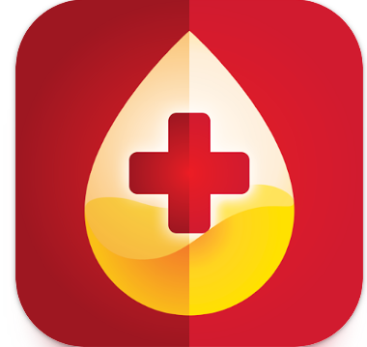
Related Work
BloodLine - Blood Bank App BD
Creniputer Lab 2019
Red
Nehad younis 2019
Providing blood types through communication between donors and those who need blood types
Post a donation request
Providing blood types through communication between donors and those who need blood types
PlasmaLife - Blood/Plasma Bank
Creniputer Lab 2020
Search for active donors by blood type and location.
Send plasma/blood request to nearby donors

Slide 15
Shortcomings in BloodLine - Blood Bank App and Red App
Time-Consuming Examination: this apps do not provide quick and easy tools for users to assess their eligibility to donate blood, leading to lengthy examination processes.
Complex medical Data: understanding and analyzing Complete Blood Count (CBC) reports can be complex and time-consuming.
Lack predictive tools: identifying medical conditions that may prevent a person from donating.
Inefficient process store: the blood donation process can be inefficient, leading to a less optimal experience for donors and collection inefficiencies for hospitals.
Ineffective communication: between who need blood communication between blood banks and potential donors is often inefficient, leading to missed donation opportunities

Slide 16
Need to extend
we connect him directly to the nearest hospitals that have patients in need of a donation.
Saving time for the medical sector in examining people By Helping people to know if they are eligible to donate
Providing Google Maps helps people go directly to hospitals.
in this app we use OCR to understand CBC report and provide the result of the analysis to determine whether the person can donate or not
Within this app we use of a chatbot can predict a disease that would prevent a person from donating
By integrating QR codes into the blood donation process, we can significantly enhance the experience for donors and improve the efficiency of blood collection for hospitals
Utilize notifications to promptly request the needed blood type, ensuring timely donations to save lives.

Slide 17
06
Implementation

Slide 18
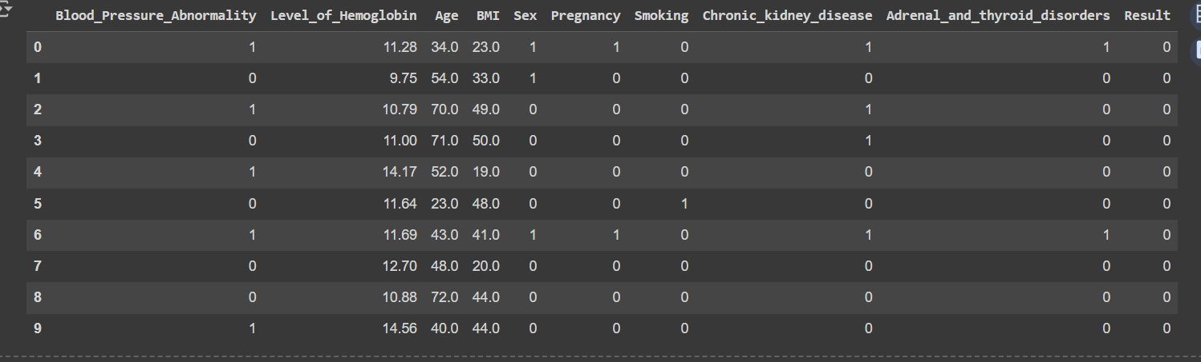
Dataset for blood donation
Forming a sample categorized into children, men, and women.
The objective was to assess whether an individual is eligible for blood donation, based on specific criteria established by the world health organization.
Forming a sample categorized into children, men, and women.

Slide 19
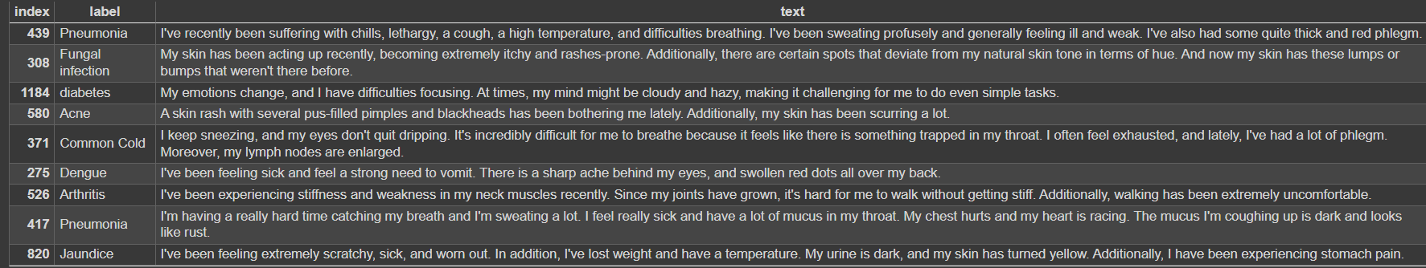
Dataset for Disease
a meticulously curated dataset, which provides essential details about the disease,
The dataset is divided into two columns: "label" and "text", where the "label" column contains the disease label associated with each symptom description.
The dataset includes 42 diseases with 50 symptom descriptions, providing a comprehensive overview of common health conditions.

Slide 20
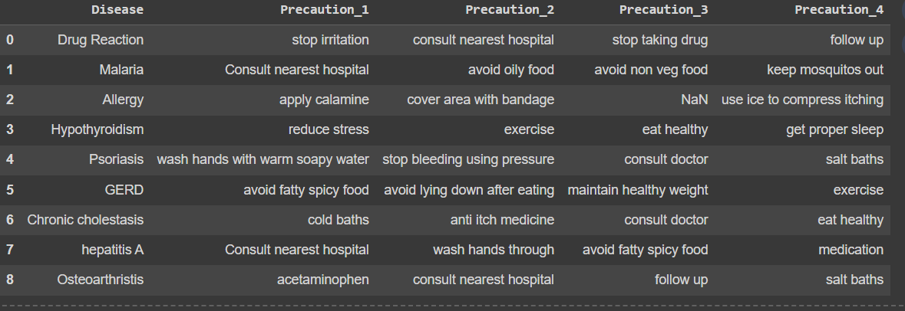
Dataset for precaution
The chatbot utilizes the " symptom_precaution " a meticulously curated dataset, Which provides precise details on how to deal with the disease
The dataset is divided into five columns: "Disease","Precaution_1", "Precaution_2""Precaution_3"and "Precaution_4", where the " Disease " The column contains the label of the disease associated with the actions that the patient should take in consideration
The dataset includes 42 diseases and each disease have 4 precaution that
help user to know how to deal with the disease.

Slide 21
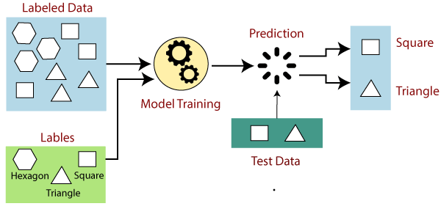
Blood Donation
Using this information, we apply a supervised machine learning model to predict whether the user is eligible to donate blood. Supervised machine learning involves training a model on a labeled dataset, where the outcome (eligible or not eligible) is known. The model learns patterns and associations in the data, allowing it to make predictions on new, unseen data.
By leveraging supervised machine learning, we can effectively assess the eligibility of users for blood donation based on their health and demographic information. This approach ensures a systematic and data-driven decision-making process
Model used:
XGBOOST
Decision Tree Classifier
Support Vector Classifier (SVC)
Logistic Regression
Random Forest Classifier

Slide 22
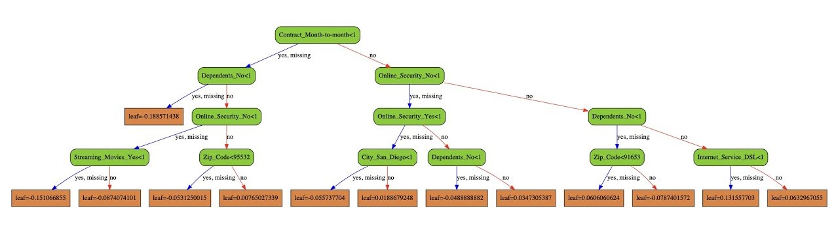

XGBOOST
short for Extreme Gradient Boosting.It belongs to the gradient boosting family and sequentially builds a series of decision trees to improve predictive accuracy.
Hyperparameters:
n_estimators, max_depth and learning-rate
The Accuracy of XGBOOST: 99.0 %

Slide 23
Accuracy

Slide 24
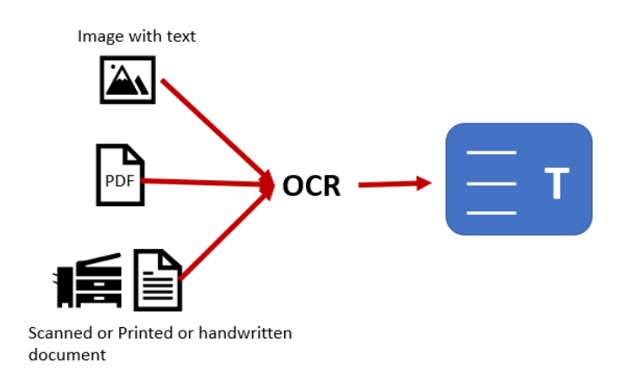
Optical Character Recognition (OCR) system
OCR (Optical Character Recognition) is a technology that converts various types of documents, into editable and searchable data.
Functionality of the OCR:
First, we used OCR to analyze images of CBC test reports uploaded.
The OCR recognize the text and numeric values to convert them into digital data that can be further processed.
Finally, OCR return the result after analyzing image ,Which return the donation eligibility and the value of hemoglobin if the result is normal .

Slide 25
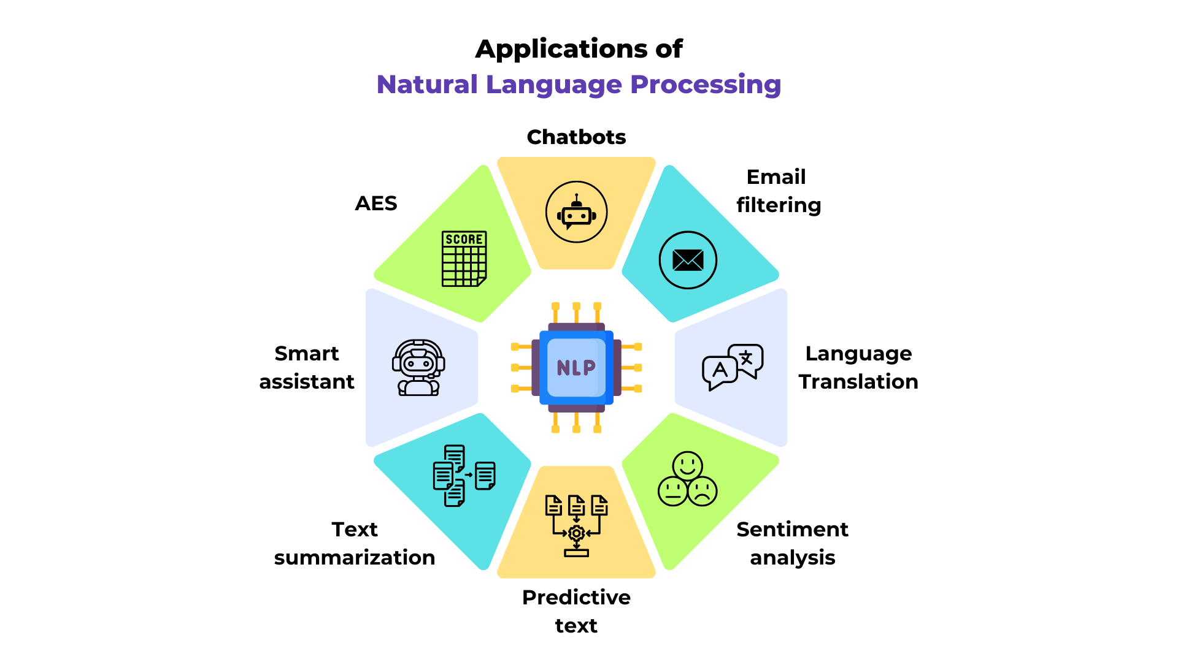
Natural Language Processing (NLP)
The goal of NLP is to enable computers to understand, interpret, and generate human language in a way that is both meaningful and useful.
Lowercase and Strip: Convert all text in the columns to lowercase and remove leading/trailing whitespace.
string.punctuation: A string containing all punctuation characters.
Remove Punctuation: Eliminate punctuation from the columns..
Tokenize: Split the text into individual words.
Remove Stopwords: Filter out common English stopwords from the tokenized words..
Lemmatize: Convert words to their base forms using lemmatization.

Slide 26
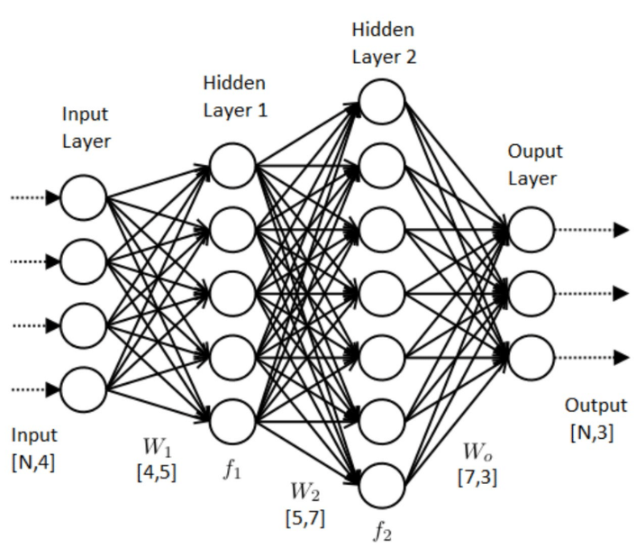
Neural Network Model
A neural network model is a supervised machine learning algorithm used for classification tasks. It consists of layers of neurons that process input features to make predictions. Here is a step-by-step explanation:
Model Building
A Sequential neural network model is created with:
An input layer with 128 neurons and ReLU activation function.
A hidden layer with 64 neurons and ReLU activation function.
An output layer with a number of neurons equal to the number of classes, using softmax activation for classification.
The Accuracy of Neural Network Model is: 92.8 %

Slide 27
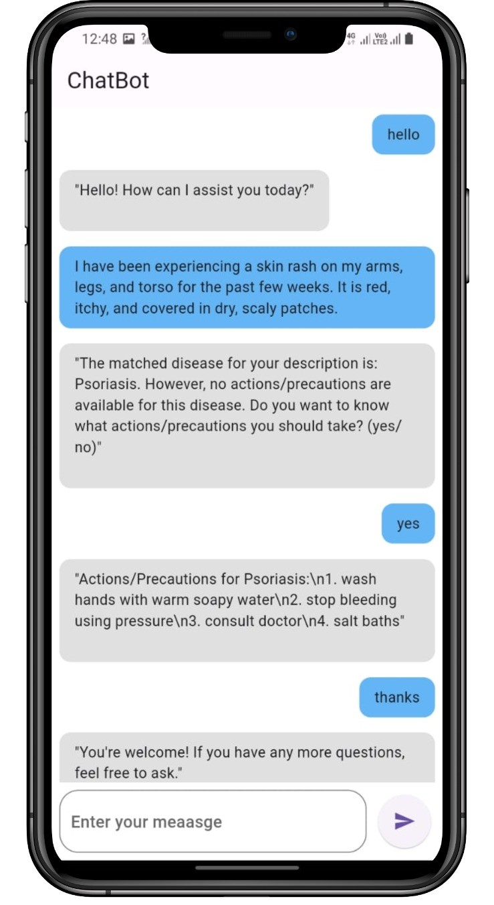
chatbot
After determining whether the user is eligible to donate, if they are not eligible, the application will redirect
them to the chatbot.
The user can express their feelings and concerns, and the chatbot will assist them in identifying their health issues and recommend appropriate actions or precautions.
Using natural language processing (NLP) enhances the communication between the user and chatbot
It allows the chatbot to understand and interpret user input more effectively, leading to a more natural and seamless interaction experience.

Slide 28
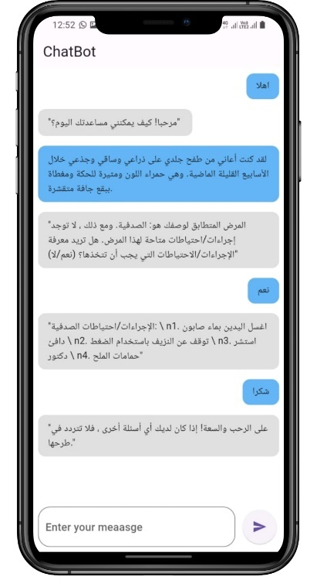
1. Disease Symptom Chatbot Matches user-provided symptoms to diseases and suggests actions or precautions. 2. Purpose Helps users identify potential diseases based on symptoms and provides actionable advice. 3. Code Overview Responds to greetings and farewells, processes symptom descriptions, and provides disease information and actions. 4. Greeting and Farewell Responses Recognizes and responds to basic greetings and farewells, offering a friendly interaction. 5. Handling Common Questions Addresses simple questions about its state and responds politely to expressions like 'How are you?'.
Disease Symptom Chatbot

Slide 29
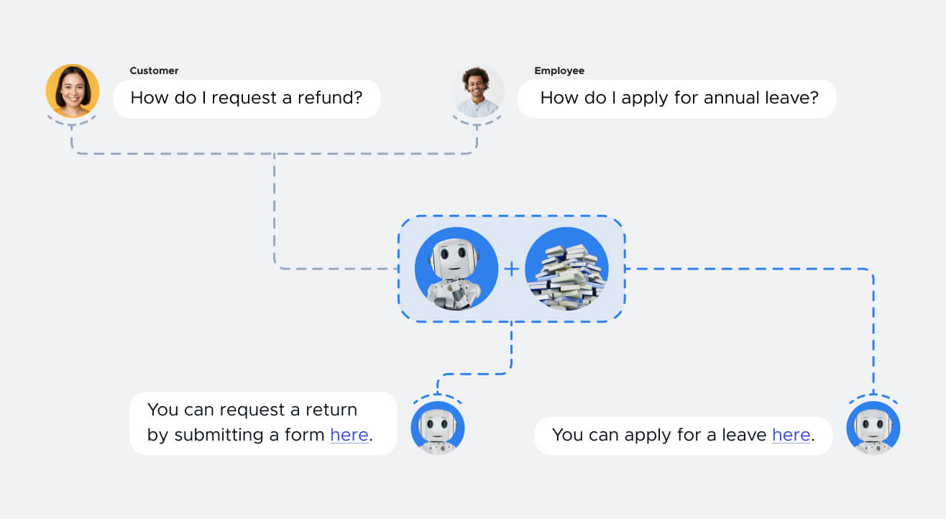
8. Response with Actions/Precautions : Asks users if they want to know actions or precautions for the identified disease and provides detailed steps if requested. 9. User Interaction Interactively handles user responses, providing detailed action lists if needed, and continues to assist with further questions. 10. Conclusion Assists users in identifying possible diseases and providing useful actions or precautions. Future improvements could enhance the disease database and NLP accuracy.
6. Symptom Matching Uses TF-IDF vectorization and cosine similarity to match user symptoms with disease descriptions in the database. 7.Disease Identification Identifies the most likely disease if the similarity score exceeds a threshold and checks for available actions or precautions.

Slide 30
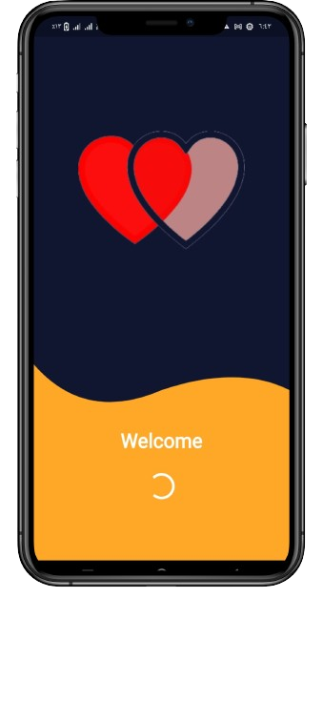
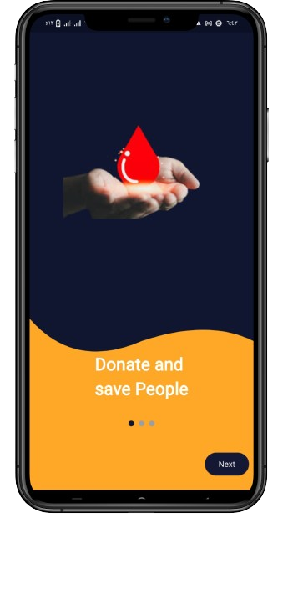
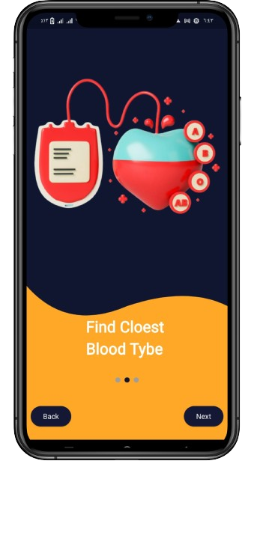
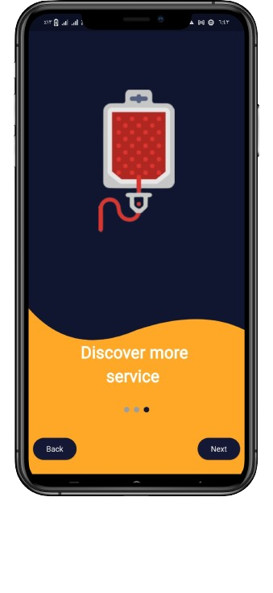
Blood Donation Locator

Slide 31
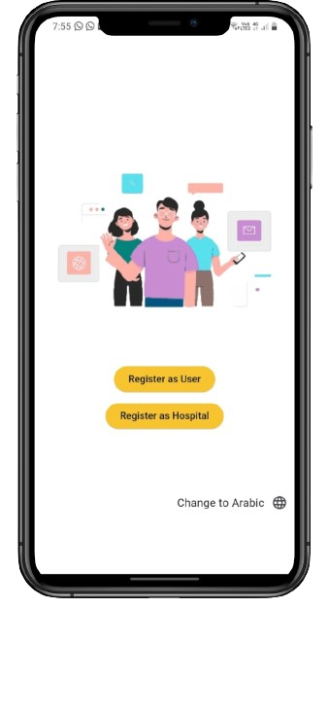
Join App view
In the second phase, we decided to expand the business and invention to serve the hospital and the user as well the start of program interface on a page and which enable to join the app
1- Personal user
2- Hospital
In addition to the possibility of choosing the appropriate language for him , expanding the use of the application in the Middle East

Slide 32
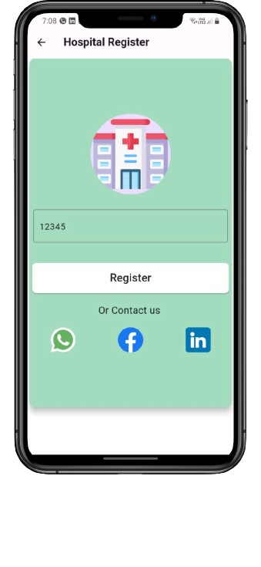
Hospital Register
The hospital can register Using a secret number Which you get after contacting us Through our various contacts, including:
1-whatsapp
2-facebook
3-linkedln
Allowing the hospital to communicate with us greatly ensures the authenticity of the hospital’s identity

Slide 33
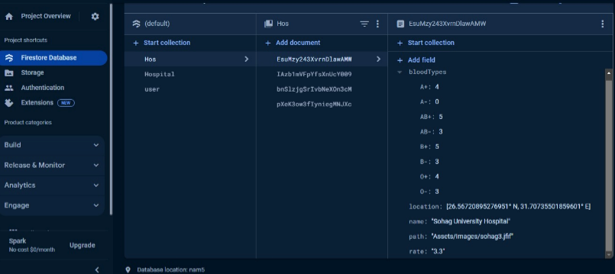
Firebase Hospital Data
We create Database collection ( Hospital ) which contain information of hospitals ( name , blood type , location , image ).

Slide 34
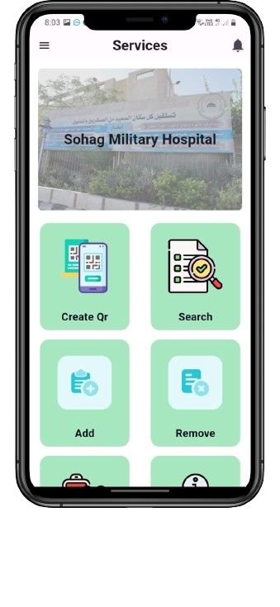
Hospital services
After entering secret key hospital will show which belongs to secret key from the database and show the services provided to the hospital:
create QR blood type
find closest blood type
add blood type
remove blood type
check donar (OCR)
info notifications

Slide 35
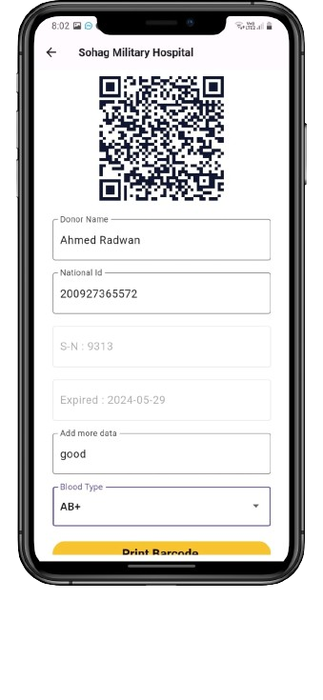
Create QR blood type
Providing this service specifically To create a QR code for blood types Which includes the details of the donor person and the time he donated,
In addition to the expiration date of this type This QR code is connected to a printer to print the QR code,
Which in turn contains the serial number Unique for each blood type

Slide 36
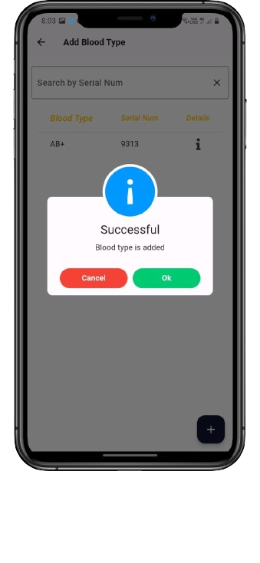
Add Blood Type
Instead of using notebooks and old methods
The second service provides the ability to add blood types easily by scanning the QR code that relates to the blood type.
Which adds it directly to the hospital's database
Immediately after adding, the show dialog appears This species was successfully added

Slide 37

Remove Blood Type
Also, instead of using notebooks and old methods for deleting blood types
Third service provides the possibility of drawing blood types easily by scanning the QR code that relates to the blood type.
Which deletes it directly from the hospital’s database, taking into account that it does not delete it unless the blood type is suitable for use. (i.e before its expiration date)
Immediately after removing , the show dialog appears This faction was successfully deleted

Slide 38
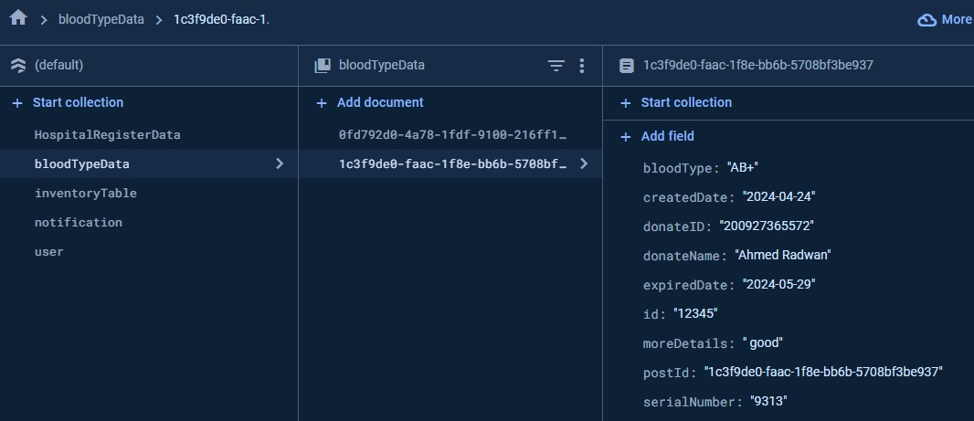
Firebase bloodTypeData
We create Database Collection (bloodTypeData) which contain information of blood type and operation was made (UpdatedDate,expiredDate,bloodType,donateName,process,serialNumber,donateID,..)

Slide 39
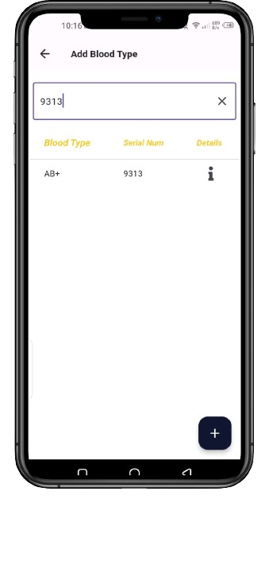
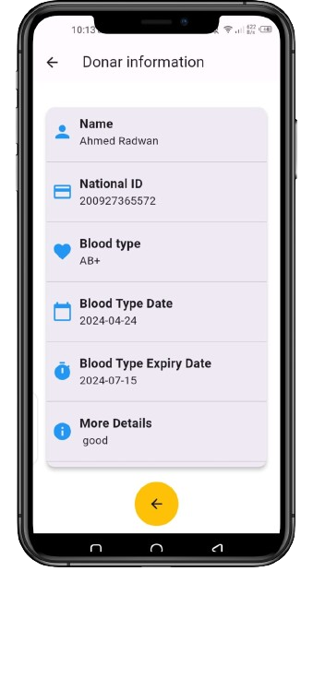
Add & Remove View Details
User can search for the blood type by serial number to access it quickly
When click on icon appear the details of blood type

Slide 40
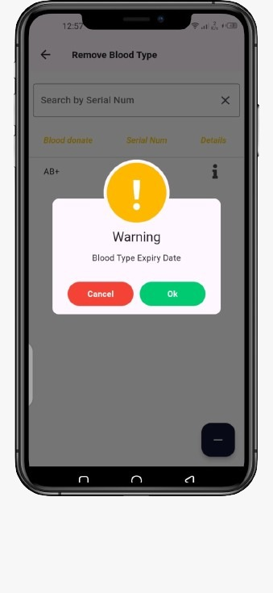
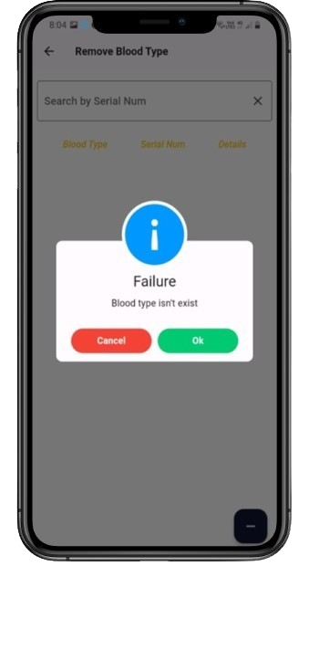
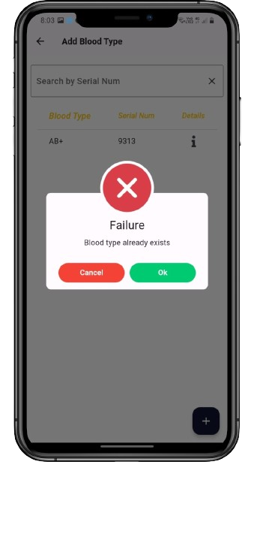
Add & Remove Mistakes
Show Dialog when try Removing blood type
has an expiry date
Show Dialog when try Removing blood type hasn't been found
Show Dialog when try Adding blood type has already been added

Slide 41
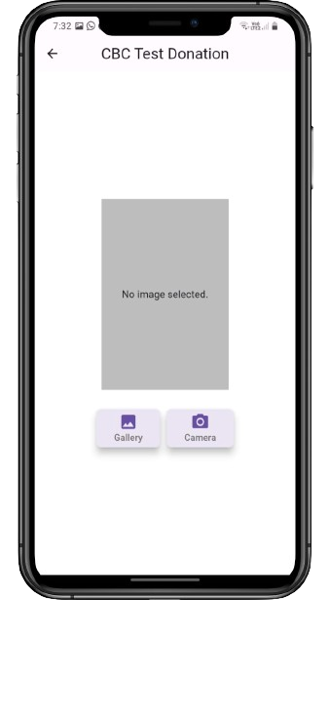
CBC Test Donation
Fourth service in application, we focus on the safety of the donor
This is done by using OCR technology
Which allows the user to upload a CBC blood test image
So, this blood analysis is done. If the donor person is safe, a show dialog will be displayed indicating the safety of the analysis
After that, he can continue to further ensure his safety, as we explained in Phase1

Slide 42
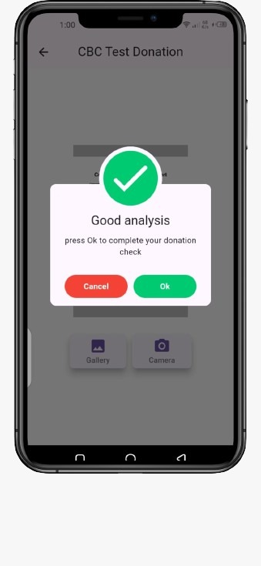
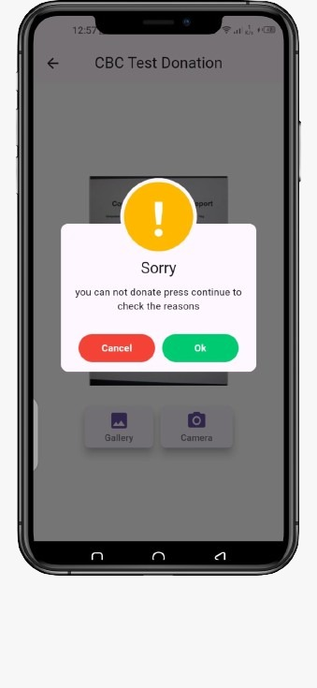
CBC Test Donation

Slide 43
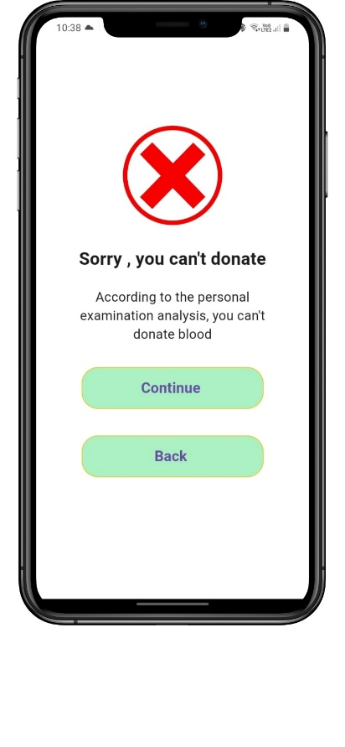
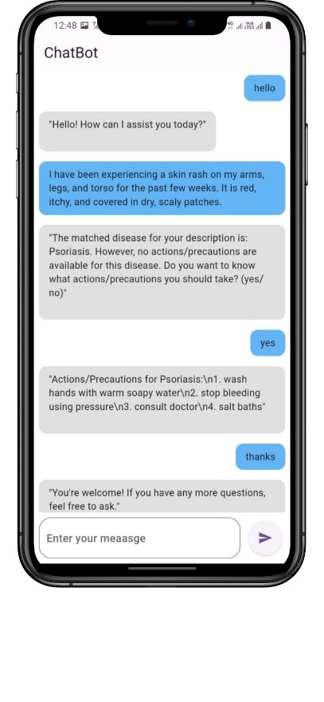
Chatbot

Slide 44
Chatbot
In the case of a person who is unable to donate due to the results of the tests
We provide in the fifth service a chatbot using artificial intelligence technology that analyzes a person's symptoms
Chatbot predicts the disease that will prevent him from donating It also provides some medical advice for each disease
It has the capability to understand and respond to input in both the Arabic and English languages

Slide 45
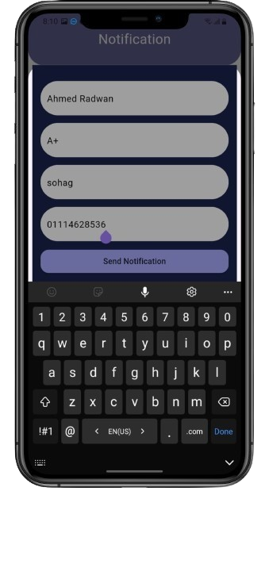
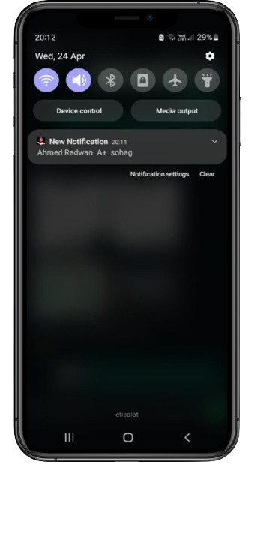
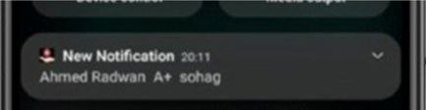
Create a Notification
The Sixth service is sending notifications to all users when there is an urgent need for blood testing.
This is done by writing Data for the person which includes His name, blood type, phone number and address
Upon pressing, the messages appear directly to all users as shown

Slide 46
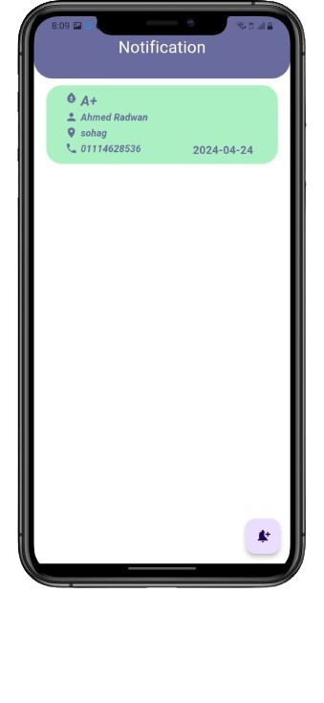
Show Notifications
After the user creates his own notification
It stores that notification in its database
Then, all the notifications that have been created are displayed on the Show Notifications page,
The page includes information about the name, blood type, mobile number, and location of user

Slide 47
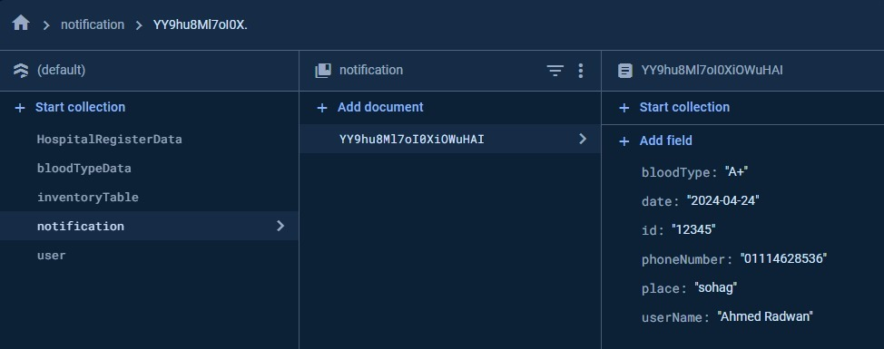
Firebase Notification
We create Database Collection (notification) which contain information of user's notification (username ,place ,phoneNumber ,date ,bloodType).

Slide 48
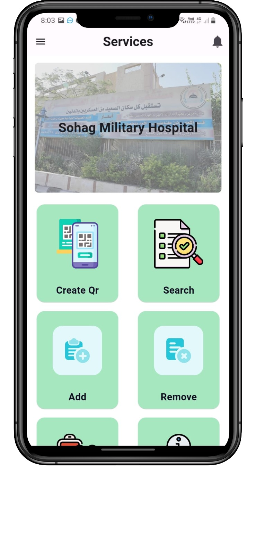
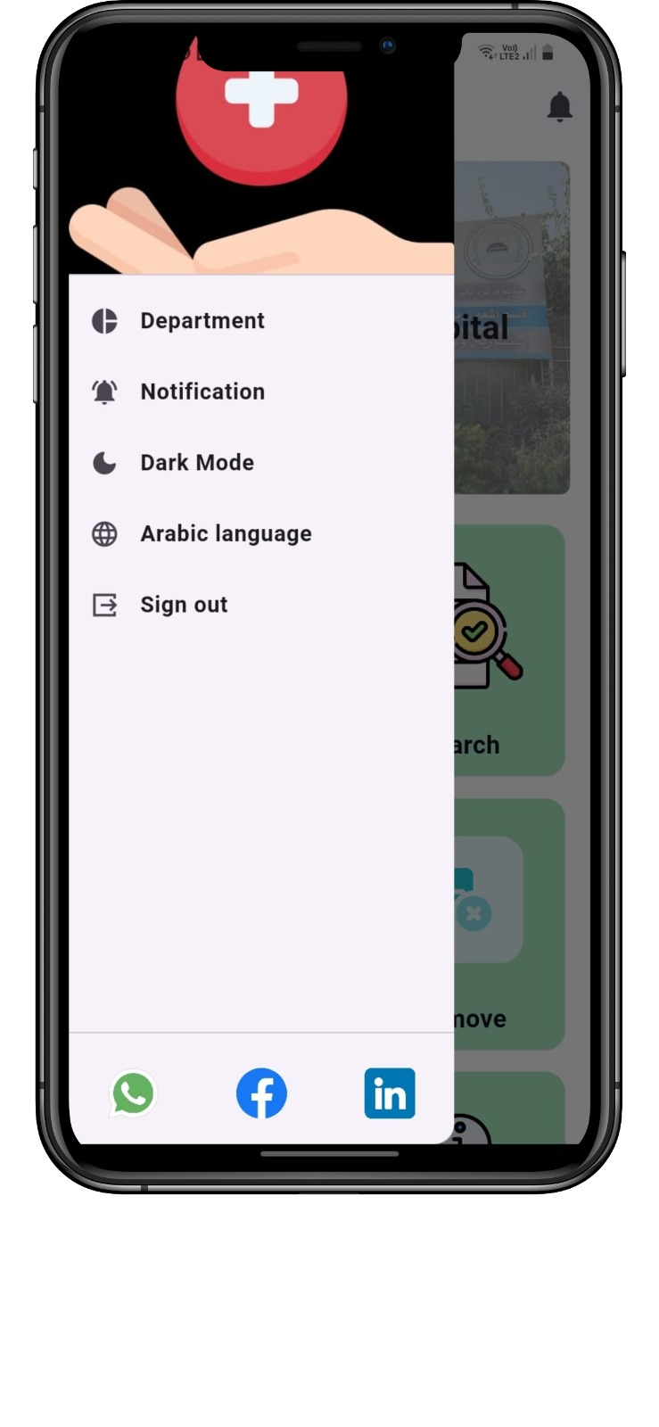
Drawer
Here hospital profile which including his:
Department
Notification
Changing between dark and light Mode
Changing between languages
Sign out

Slide 49
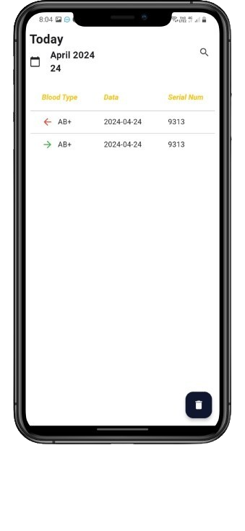
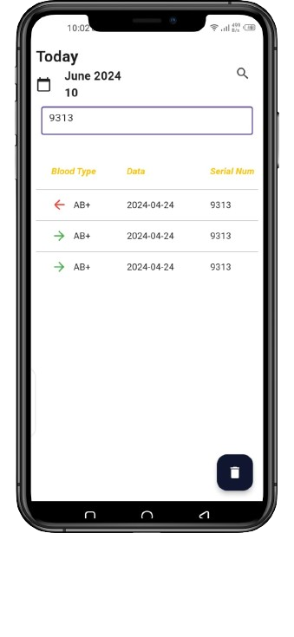
Department
This service records all operations of adding and deleting blood types daily.
By displaying a table with addition and deletion marks, blood type, operation date, and serial number.
The user can search by serial number to review blood types.
The user could remove all records

Slide 50
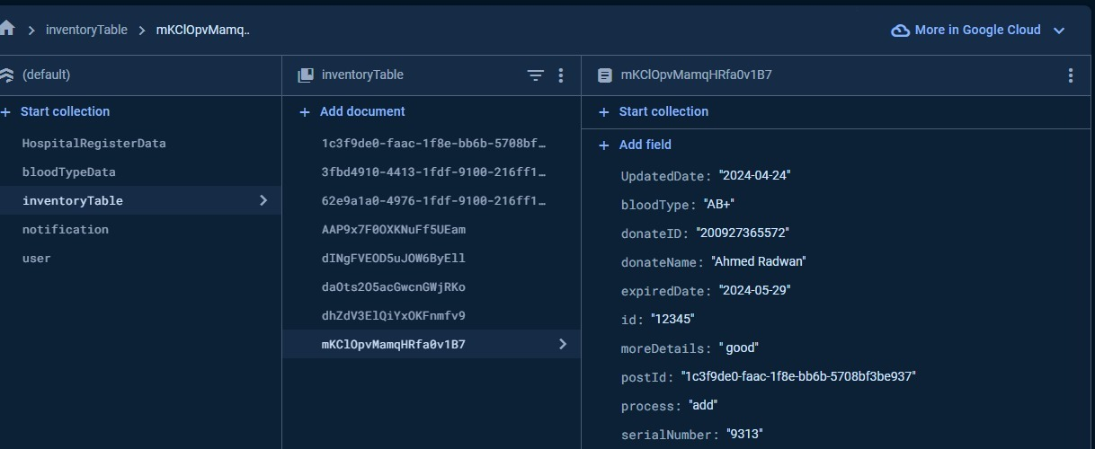
Firebase InventoryTable
We create Database Collection (inventoryTable ) which contain information of blood type and operation was made(UpdatedDate,expiredDate,bloodType,donateName,process,serialNumber,donateID,..)

Slide 51
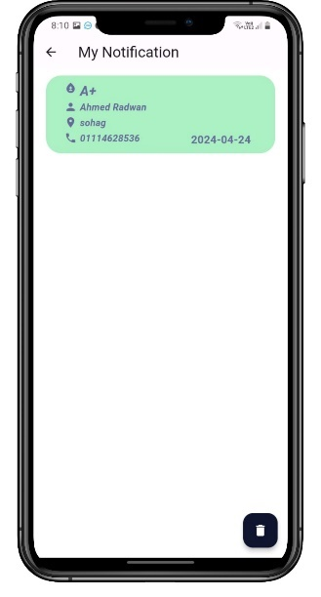
My Notification
Allows users to view their notifications.
Provides an option for users to delete notifications.Notification Management:
A list or panel displaying the notifications.
A delete button or icon next to each notification for removal.Dynamic Updates:
The page dynamically updates to reflect the current state of notifications.

Slide 52
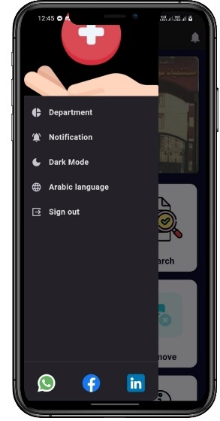
Dark & Light Theme
Toggle Switch/Button:
Design and place a toggle switch or button labeled "Dark Mode" within the app's settings
Dark Theme Development:
Develop a dark theme with a color palette suitable for low-light environments, ensuring good contrast and readability.

Slide 53
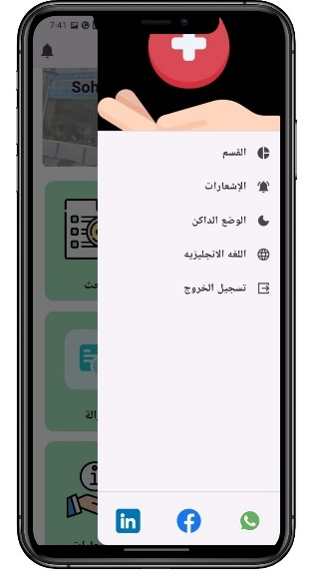
Change Language
Toggle Switch/Button:
Design a toggle switch or button labeled to switch between Arabic and English.
Place the toggle within the app's settings menu or prominently on the main interface for easy access.
Ensure the button clearly indicates the current language and the language to switch to.

Slide 54
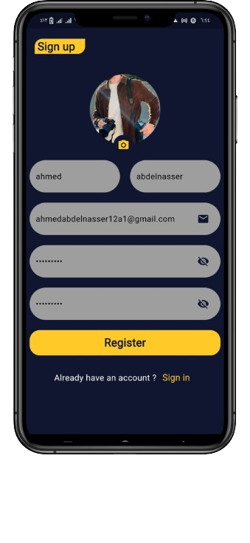
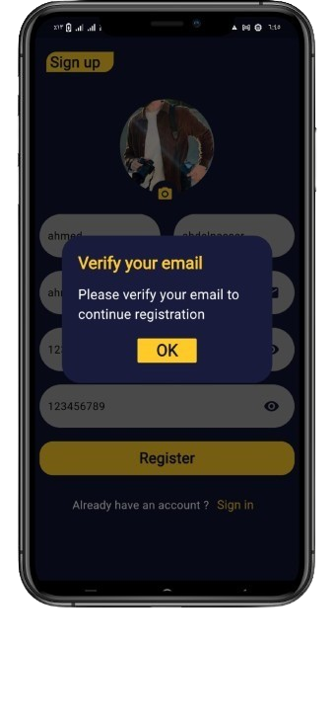
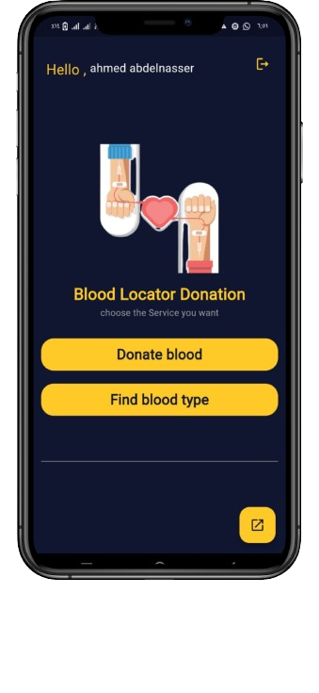
User Service

Slide 55

Firebase Authentication
We create firebase Authentication by used sign in method with:
Email.
Password.

Slide 56

Firestore Database
We create Database collection ( user ) which contain information of users (name , email ,image ,password ).

Slide 57

Connection
We used django Framework To connect Flutter app with Model Ai
Steps:
First Load model ai from collab as joblib file Install Django framework and create files connection .
After finish we Extract Api as a Local host to work.
using http Package Flutter To Make Http request to retrieve data result.
converting data to JSON facilitates interoperability, simplifies data exchange between different systems.
We handled all errors and exceptions that may occur during HTTP requests.

Slide 58
OCR connection with Flask framework
We used Flask framework To connect Optical Character Recognition (OCR)
Flask App:
Purpose: Establish the framework for the application, define routes,
and handle HTTP requests.
Processed images using OpenCV and performed OCR with Tesseract.
Dockerization flask app.
Deploy Flask in Render Server and Get API.
using http Package Flutter To Make Http request to retrieve data result.
converting data to JSON facilitates interoperability, simplifies data exchange between different systems.

Slide 59
Chatbot Connection
We used Flask Framework To connect Flutter app with Model Ai
Steps:
After finish we Extract Api as a Local host to work.
using http Package Flutter To Make Http request to retrieve data result.
converting data to JSON facilitates interoperability, simplifies data exchange between different systems.
We handled all errors and exceptions that may occur during HTTP requests.

Slide 60
07
Result

Slide 61

Demo

Slide 62
08
Tools

Slide 63
Tools & Technologies
Tools ->>
Postman
Vs Code
Anaconda
Docker
Libraries-->>
Sklearn
XGBOOST
Joblib
Pytesseract
Tensorflow
NLP
Technologies ->>
Flutter
Dart
Firebase
Django
Python
flask
XGBOOST.
Chatbot.
OCR
Neutral network model
Machine Learning-->>

Slide 64
09
Future Work

Slide 65
1.collect real data from hospitals and enable their utilization to enhance healthcare outcomes
2. deploy app in app store and make it available to use.
3. Continuous Improvement: Gather feedback from users and iterate on the app to continuously improve its features and performance
4. Security Testing: Security testing evaluates the application's resilience to potential threats and vulnerabilities. Testers assess the effectiveness of security controls and validate compliance with security standards.
5. Maintenance and Support: After deployment, testing continues during the maintenance phase to address any issues that arise post-release. Testers collaborate with developers to troubleshoot and resolve reported defects.

Slide 66
10
Conclusion

Slide 67
Facilitating time efficiency for medical staff by determining whether the donor is eligible to donate or if there are any medical conditions preventing donation.
Assisting the patient in meeting their blood needs promptly and adequately.
Facilitating the donor's ability to donate and guiding them to the nearest donation center.

Slide 68
11
Time Plan

Slide 69

Time Plan Phase (1)

Slide 70

Time Plan Phase (2)

Slide 71

Thank you

